Slide 1
Person Ethos
Notes:
Warrior Creed

Slide 2

Section 1 Building Your Ethos
The Man in the Mirror, is it really you?
Notes:
Best example of this is Goggins Accountability Mirror.
Its all about making sure the real you is the reflection

Slide 3
Building Your Personal Ethos
It is Your Personal Ethos that best describes who You and Your Team are
https://www.nsw.navy.mil/NSW/SEAL-Ethos/
Notes:
Lombardi
What do you stand for…from a business perspective.
How are you known?

Slide 4
Personal Ethos by Example
A common person with uncommon desire to succeed.
Take responsibility for your actions and the actions of your teammates
Excel as a Leader through Discipline and Innovation
Train for Success, Defeat any hurdles in our ways
Earn your Personal Ethos stripes everyday

Slide 5
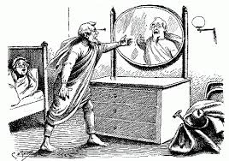
Know Yourself
You cannot improve something you do not understand
Notes:
Lombardi
Goggins
Think about your strengths and weaknesses
You have to be real with yourself

Slide 6

The Goal
The goal is to get the absolute best effort from yourself and each member on your team
Notes:
Lombardi

Slide 7

The Preparation…
The individual must look inside him or herself to understand who they are
Develop Personal discipline
Overcome any barriers Racial, Social, Physical or Personal
Study the past to become educated
Notes:
Lombardi
Googins

Slide 8

…more Preparation
Always Keep you Head in an emergency
No one person has all the qualities
Leaders made through hard effort
Must be honest with yourself and backup your team
Notes:
Warrior Creed
Lombardi
Is a process that begins inside the individual.
The individual must take responsible for developing knowledge about him or her self and fid the purpose through that purpose of self discovery.

Slide 9

Leadership Traits
Self Knowledge
Leaders are Evolutionary the process of learning never stops
Character growth – You write own character
Integrity provides the foundation for leadership
Leaders are fair, compassionate and results driven
Notes:
Lombardi

Slide 10

Be Prepared to Sacrifice
Sacrifice lies behind every success
The small hurts… learn to live with them
Selfness
Notes:
Lombardi

Slide 11
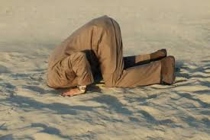
The opposite of Self-Knowledge is ignorance, misconception and misunderstanding
Knowledge is important because the way you see life will be reflected in your communication and interactions with everyone else.
Notes:
Lombardi

Slide 12

Emotional Maturity
Determine your existing strengths and build upon them
The Roots of maturity are… effective priority setting and good decision making
When your immature emotionally… you will exaggerate what is not important

Slide 13

Act Don’t React
Reflect upon your past experiences so you don’t make the same mistakes repeatedly.
Study the past to discover the truth
Relying on experience may not work in the present situations
Notes:
Lombardi

Slide 14
End Person Ethos
Notes:
Warrior Creed

